Slide 1


<Name>
<Date>

Slide 2

Outline
Executive Summary
Introduction
Methodology
Results
Conclusion
Appendix

Slide 3
Executive Summary
Summary of methodologies
Summary of all results

Slide 4
Introduction
Project background and context
Problems you want to find answers

Slide 5

Section 1

Slide 6
Methodology
Executive Summary
Data collection methodology:
Data was collected through a get request to the SpaceX Rest API
Data was scraped from the Falcon 9 historical launch records from wikipedia
Perform data wrangling
Filtered data for only Falcon 9 rockets and missing values were replaced with mean
Perform exploratory data analysis (EDA) using visualization and SQL
Perform interactive visual analytics using Folium and Plotly Dash
Perform predictive analysis using classification models
Built multiple models and evaluated them based on accuracy and visualization

Slide 7
Data Collection
Data collection was done by two methods:
1. Collected data through the SpaceX Rest API using get requests to the following API:
https://api.spacexdata.com/v4/rockets/
2. Collected data by web scraping the Wikipedia page for historical Falcon 9 launches.
https://en.wikipedia.org/wiki/List_of_Falcon_9_and_Falcon_Heavy_launches

Slide 8
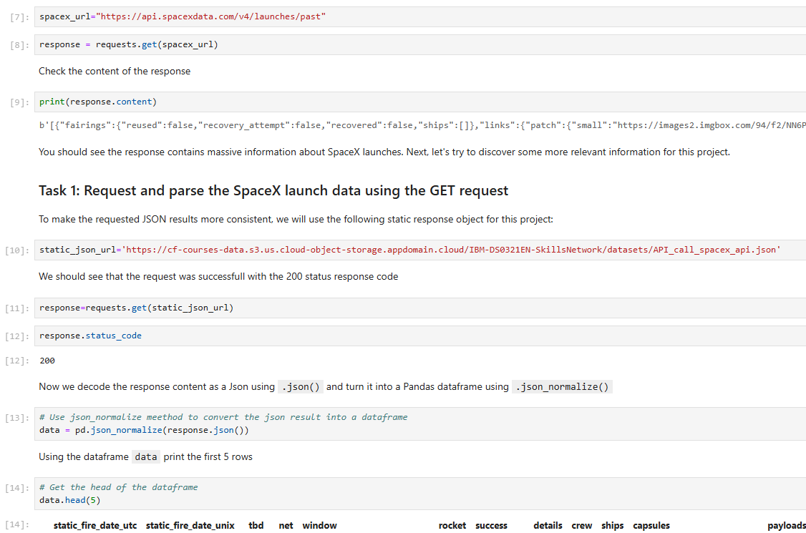
Data Collection – SpaceX API
A get request was used on the SpaceX Rest API to retrieve data and decode it into a json format. This was then transformed into a pandas dataframe for easier manipulation and analysis.
https://github.com/jdowling23/Applied-Data-Science-SpaceX-Launch/blob/main/jupyter-labs-spacex-data-collection-api.ipynb
Place your flowchart of SpaceX API calls here

Slide 9
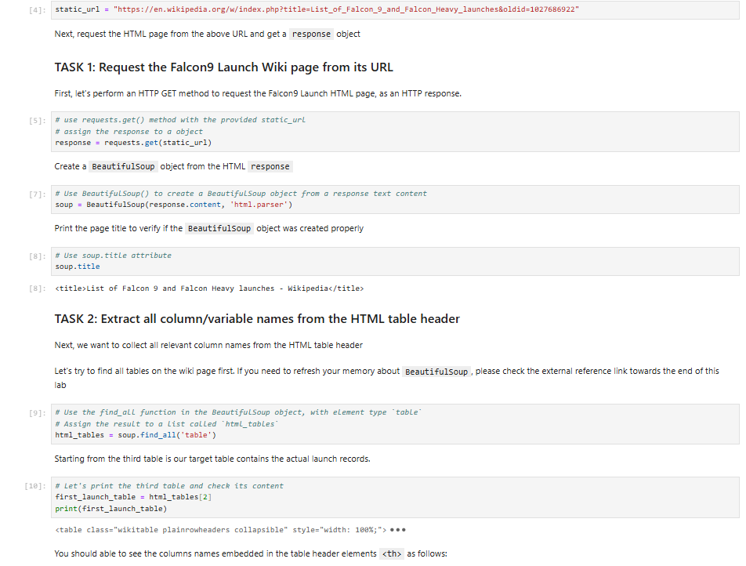
Data Collection - Scraping
Performed web scraping on the historical falcon 9 launches from the table on the wikipedia page. This was done using requests and BeautifulSoup libraries. Then created a dataframe from the html table.
https://github.com/jdowling23/Applied-Data-Science-SpaceX-Launch/blob/main/jupyter-labs-webscraping.ipynb
Place your flowchart of web scraping here

Slide 10
Data Wrangling
After the data collection process was complete and data was in a pandas dataframe, it was filtered on the ‘booster-version’ to get only the falcon 9 rocket data.
The Payload Mass column had missing values so the mean value of that column was used to replace them.
https://github.com/jdowling23/Applied-Data-Science-SpaceX-Launch/blob/main/labs-jupyter-spacex-Data%20wrangling.ipynb

Slide 11
EDA with Data Visualization
Scatter plots were used to visualize data relationships
Launch Site vs Flight Number
Launch Site vs Payload Mass
Orbit vs Flight Number
Orbit vs Payload Mass
Bar Chart was used to visualize Success vs Orbit type
Line Chart was used to visualize success rate vs year
https://github.com/jdowling23/Applied-Data-Science-SpaceX-Launch/blob/main/EDA_feature_engineering.ipynb

Slide 12
EDA with SQL
Display the names of the unique launch sites in the space mission
Display 5 records where launch sites begin with the string 'CCA'
Display the total payload mass carried by boosters launched by NASA (CRS)
Display average payload mass carried by booster version F9 v1.1
List the date when the first succesful landing outcome in ground pad was acheived
List the names of the boosters which have success in drone ship and have payload mass greater than 4000 but less than 6000
List the total number of successful and failure mission outcomes
List all the booster_versions that have carried the maximum payload mass, using a subquery with a suitable aggregate function.
List the records which will display the month names, failure landing_outcomes in drone ship ,booster versions, launch_site for the months in year 2015.
Rank the count of landing outcomes (such as Failure (drone ship) or Success (ground pad)) between the date 2010-06-04 and 2017-03-20, in descending order.
https://github.com/jdowling23/Applied-Data-Science-SpaceX-Launch/blob/main/SpaceX%20EDA%20using%20SQL.ipynb

Slide 13
Build an Interactive Map with Folium
A map was created using Folium to show the locations of launch sites. These launch sites were marked with circles and labeled. Lines were used to visualize distance from nearest coast lines and roads. The launch success/failures were also added to each launch site.
These markers were added to visualize the number of success/failures for each launch site on a map of the US.
https://github.com/jdowling23/Applied-Data-Science-SpaceX-Launch/blob/main/Data%20Analysis%20of%20Launch%20Sites%20with%20Folium.ipynb

Slide 14
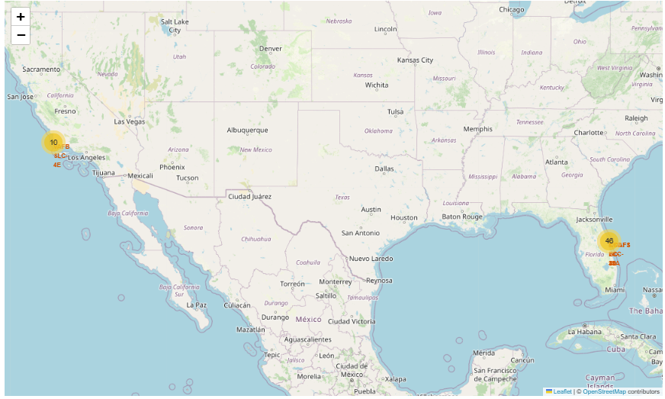
Interactive Map with Folium

Slide 15
Build a Dashboard with Plotly Dash
A plotly dashboard was created to interact with. A drop down menu contains the different launch sites where when chosen a pie chart and scatter plot as updated with the data for that particular locations launch success and failure.
This dashboard is user friendly and easy to interact with while providing informative and easy to read data points about the launch success rate for each location.
https://github.com/jdowling23/Applied-Data-Science-SpaceX-Launch/tree/main/SpaceX-Dashboard

Slide 16
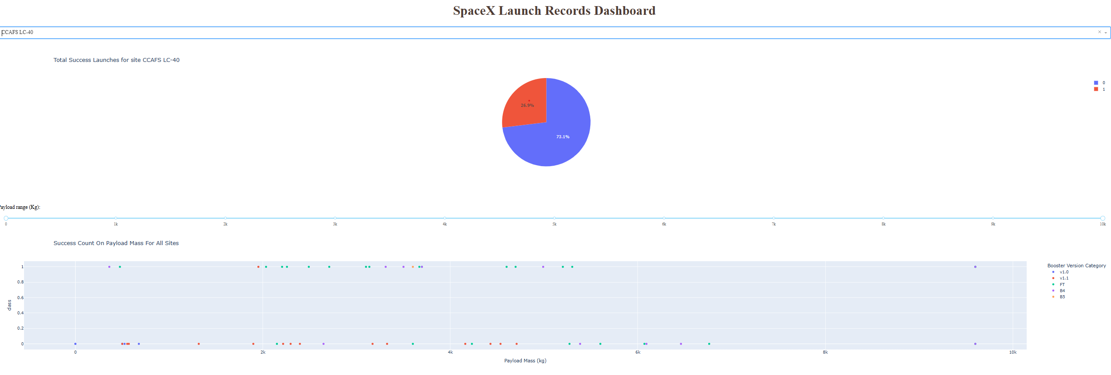
Dashboard with Plotly Dash

Slide 17
Predictive Analysis (Classification)
Models used for predictive analysis
Logistic Regression
Support Vector Machine
Decision Tree
K-Nearest Neighbor
Used train_test_split function to gather training and testing data for models above. Measured the accuracy score and visualized accuracy in a confusion matrix.
https://github.com/jdowling23/Applied-Data-Science-SpaceX-Launch/blob/main/SpaceX_Machine%20Learning%20Prediction.ipynb

Slide 18
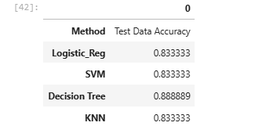
Predictive Analysis (Classification)
Comparing the accuracy of the different models:

Slide 19
Results
Exploratory data analysis results
Success rate has increased over time since 2014
Heavy payloads are more successful for Polar, LEO and ISS orbits
Interactive analytics demo in screenshots
Predictive analysis results
The decision tree provided the most accurate score among the models used, at 88% when predicting launch success rates.

Slide 20

Section 2

Slide 21
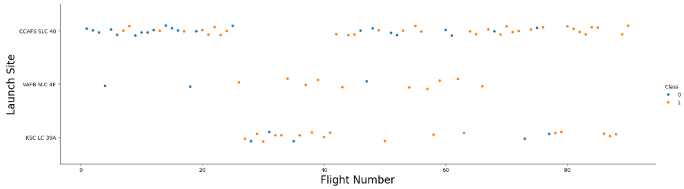
Flight Number vs. Launch Site
The majority of the flights occurred at the CCA launch site and we saw success rate increase with increase in flight number.

Slide 22
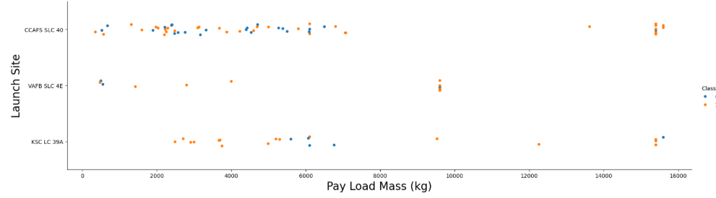
Payload vs. Launch Site
There were no heavy payloads launched from the VAFB site. While the success rate for heavy payloads at the other 2 sites had a high success rate.

Slide 23
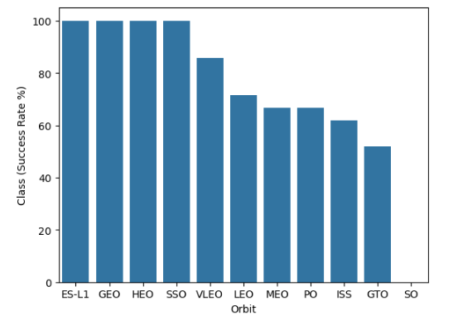
Success Rate vs. Orbit Type
Bar chart for the success rate of each orbit type
ES-L1, GEO, HEO, and SSO orbits had a 100% success rate.
SO orbits had either zero launches or zero success

Slide 24
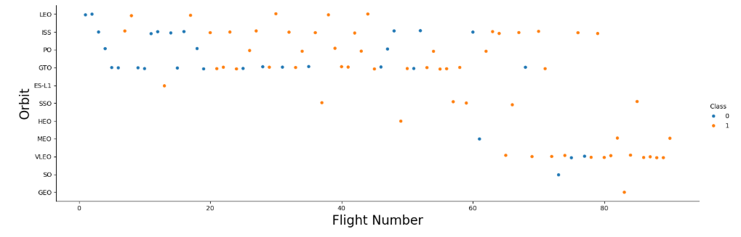
Flight Number vs. Orbit Type
LEO orbits seem to be more successful with increase in flight number. Where GTO orbits seem to have no correlation.

Slide 25
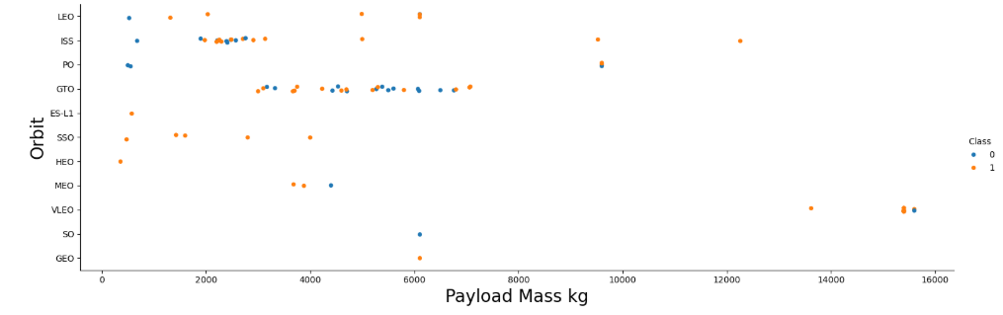
Payload vs. Orbit Type
Heavy payloads have a higher success rate for LEO, ISS, and Polar orbits
GTO orbits seem to be unrelated as both success and failed launches are present

Slide 26
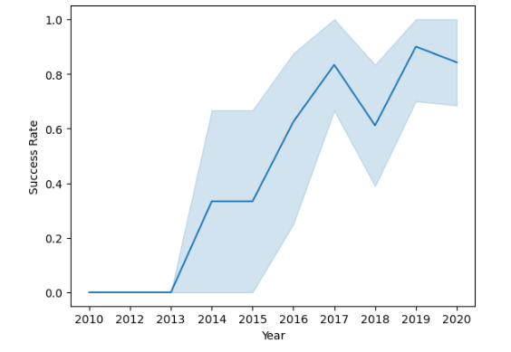
Launch Success Yearly Trend
The success rate has continued to increase since 2013 with the exception to a slight dip in 2018.

Slide 27
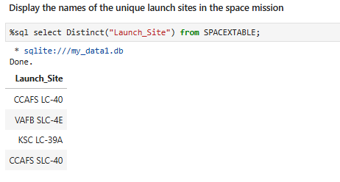
All Launch Site Names
Find the names of the unique launch sites

Slide 28
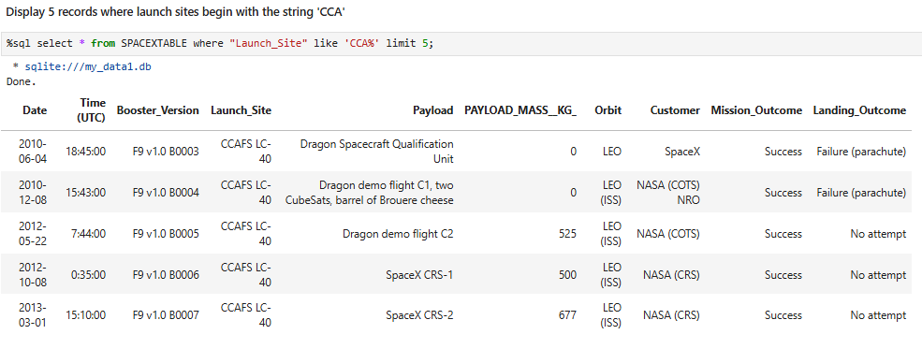
Launch Site Names Begin with 'CCA'
Find 5 records where launch sites begin with `CCA`
Use the ‘like’ keyword and ‘%’ in the string to find sites with ‘CCA’

Slide 29
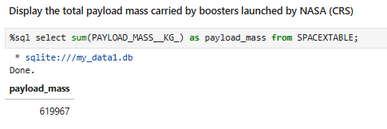
Total Payload Mass
Calculate the total payload carried by boosters from NASA
Used the ‘sum()’ function to find the total payload mass from all launches.

Slide 30
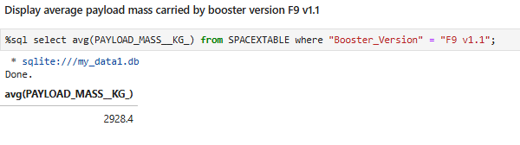
Average Payload Mass by F9 v1.1
Calculate the average payload mass carried by booster version F9 v1.1
Used the ‘avg()’ function and filtered on ‘Booster_Version’ for desired results of 2928.4 KG

Slide 31
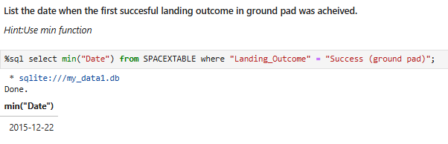
First Successful Ground Landing Date
Find the dates of the first successful landing outcome on ground pad
Used the ‘min’ function on the Date column and filtered on the Landing_Outcome column to get the first successful ground landing date.

Slide 32
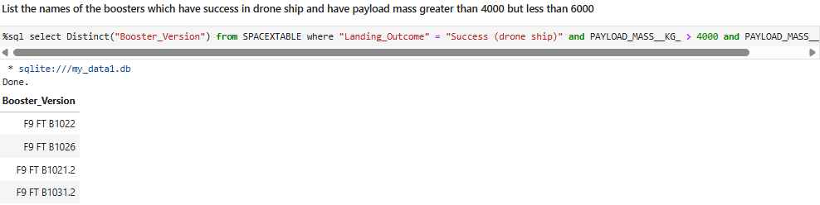
Successful Drone Ship Landing with Payload between 4000 and 6000
List the names of boosters which have successfully landed on drone ship and had payload mass greater than 4000 but less than 6000
Used Distinct to filter Booster_Version and filtered on Landing_Outcome column for “Success (drone ship)” as well as desired payload mass values

Slide 33
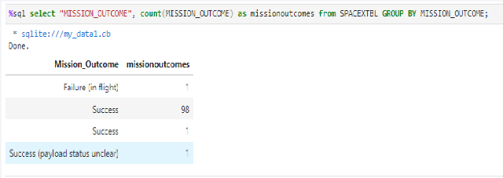
Total Number of Successful and Failure Mission Outcomes
Calculate the total number of successful and failure mission outcomes
Used count function on Mission_Outcome column and grouped by same column to get counts of success and failed missions.

Slide 34
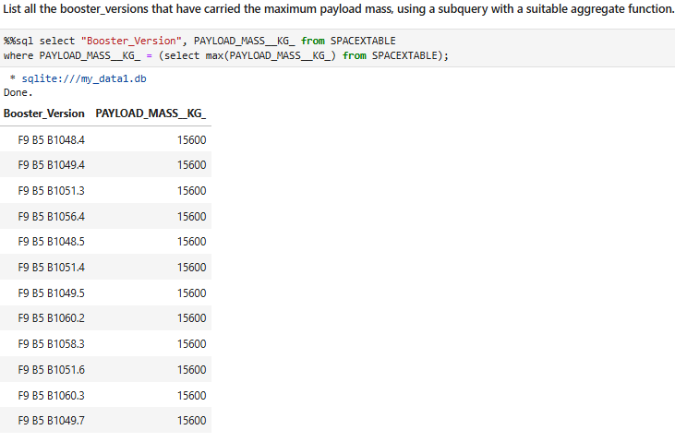
Boosters Carried Maximum Payload
List the names of the booster which have carried the maximum payload mass
Used a subquery for PAYLOAD_MASS__KG_ column and the ‘max’ aggregate function.

Slide 35
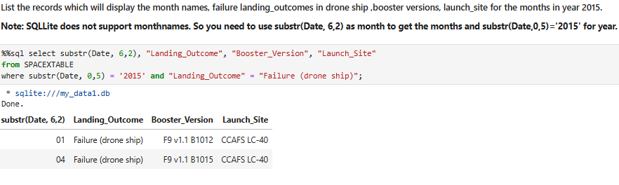
2015 Launch Records
List the failed landing_outcomes in drone ship, their booster versions, and launch site names for in year 2015
Used the substr function on Date column to get the required month in the year 2015. Also filtered on Landing_Outcome for “failure (drone ship)”

Slide 36
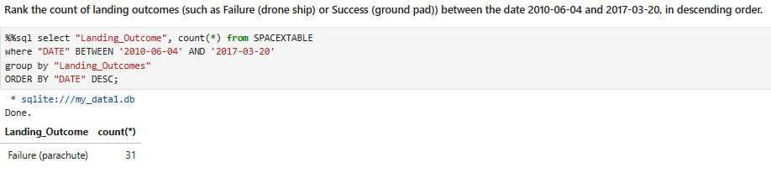
Rank Landing Outcomes Between 2010-06-04 and 2017-03-20
Rank the count of landing outcomes (such as Failure (drone ship) or Success (ground pad)) between the date 2010-06-04 and 2017-03-20, in descending order
Used aggregate count function and filtered between the desired dates. Grouped by Landing_Outcomes column and ordered by date descending.

Slide 37

Section 3

Slide 38
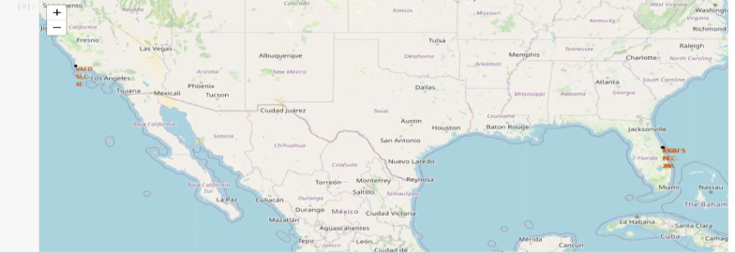
SpaceX Launch Sites – Folium Map
There are a total of 4 launch sites shown on this map of the US labeled in red text.
VAFB SLC-4E
KSC-LC29A
CCAFS-LC40
CCAF-SLC40

Slide 39
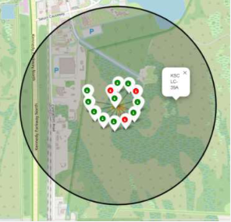
Launch Site Outcomes
Kennedy Space Center (FL) – KSC-LC29A
This shows the successful launch outcomes in green and failed launch outcomes in red for this particular launch site.
10 successful, 3 failed

Slide 40
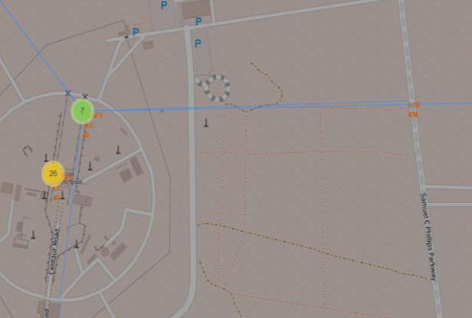
Launch Site proximity
This is a Launch Site in Cape Canaveral (CCAFS-SLC40)
This graphic shows the launch site with blue lines demonstrating the distance between the closest highway at .58 KM.

Slide 41

Section 4

Slide 42
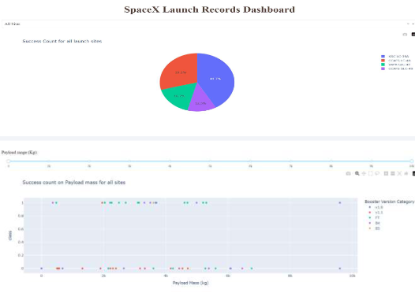
Plotly Dashboard All Sites
This Dashboard has a drop down menu to choose the launch site. As well as a pie chart and scatter plot to demonstrate the data for the chosen launch site.
This dashboard shows the Success rate for all launch sites as default since there is no launch site chosen.

Slide 43
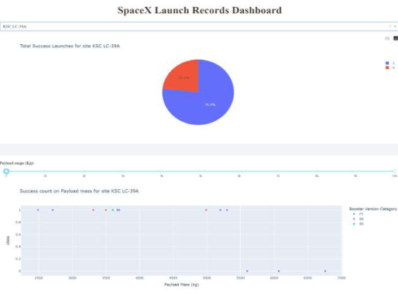
KSC-LC29A Launch Site
KSC-LC29A is the launch site with the highest success rate as shown in the pie chart.
Payload ranges with highest and lowest success rate
F9 booster version (v1.0, v1.1, FT, B4, B5, etc) with highest launch success rate.

Slide 44
Payload vs Launch Outcome
Show screenshots of Payload vs. Launch Outcome scatter plot for all sites, with different payload selected in the range slider
F9 booster version (v1.0, v1.1, FT, B4, B5, etc) with highest launch success rate.

Slide 45

Section 5

Slide 46
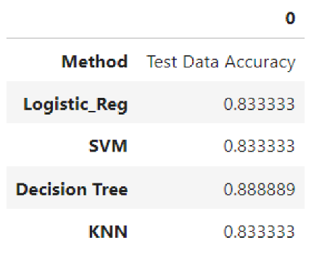
Classification Accuracy
The different models presented similar accuracy results with the Decision Tree being slightly better at 89% accuracy.

Slide 47
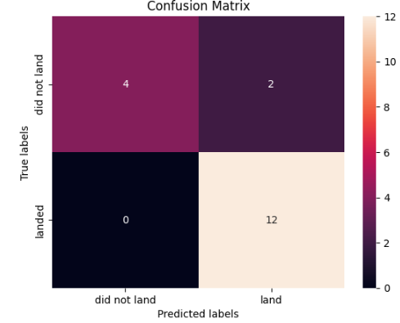
Confusion Matrix
Confusion Matrix for the Decision Tree which was the most accurate.
4 True positives (top left)
2 False positives (top right)
0 False Negatives (bottom left)
12 True Negatives (bottom right)

Slide 48
Conclusions
Different launch sites have different success rates with CCAFS LC-40 success rate at 60% while KSC LC-39A and VAFB SLC4E have 77% success rate.
The data shows that the success rate increases with the increase in number of flights for each site.
The ES-L1, GEO, HEO and SSO orbits have the highest success rates at 100%
LEO orbit succes rate seems to be correlated to flight number while GTO orbit has no relation.
Polar, ISS and LEO are more successful with heavy payloads than other orbits.
Success rates have continued to increase since 2013

Slide 49
Appendix
Github project link which includes all jupyter notebooks:
https://github.com/jdowling23/Applied-Data-Science-SpaceX-Launch/tree/main

Slide 50


